Slide 1
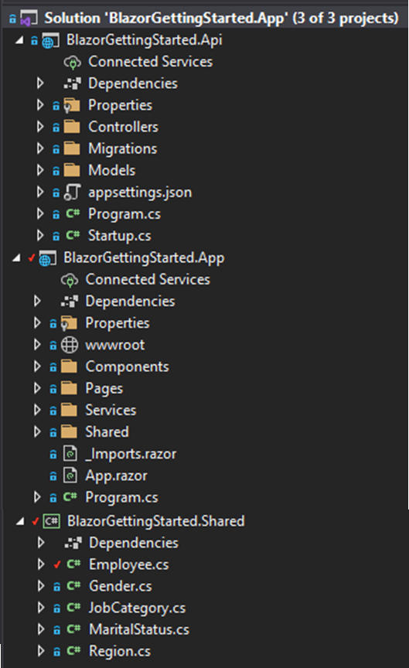
Exposes data from database through API endpoints. To be consumed by other applications.
Exposes data from the database through API endpoints and contains the HTTP Request RESTful Methods for interacting with the DB; ties these to the CRUD methods
Entity Framework Migrations
Contains the database data layer, interfaces and implementations for CRUD
Configures db context, http request pipeline, adds services to container
Consumes API data and uses for the Blazor website.
Contains static files and the route index.html
Components for re-use within this project only. Nesting where needed.
Contains razor components; pages of the website with code behind .cs classes providing the computation and data exposing functionality.
Services set up and registered with the DI container services collection, so that they can be injected into components.
Contains the shared components that are visible on many pages of the application e.g. navbar.
Configuration of HttpClient (HttpClientFactory) and service registration.
Provides the entity data model for the required objects. In a separate project so that it can be used by both the API and the App project.
Component Library can be set up for components to re-use across applications, like a .Common class library.

